Slide 1
Which area would be most susceptible to extend Dezod_brand?
DEZOD_BRAND

Slide 2

PROJECT DESCRIPTION
Dezod_brand is a collection of clothes such as: t-shirts, pants, hats etc. Dezodbrand wants to conquer other international markets so they decided to put the brand in toronto. The marketing team needs to do a field study in the Toronto area to see which city of Toronto would be best for us to launch the brand.
Part 1:
Project Description

Slide 3


Table of Methodology
Part 1:
Problem statement
Part 3:
Data Preprocessing
Part 2:
Data Collection
Part 4:
Summary
Part 5:
Visualization
Part 6:
Result

Slide 4
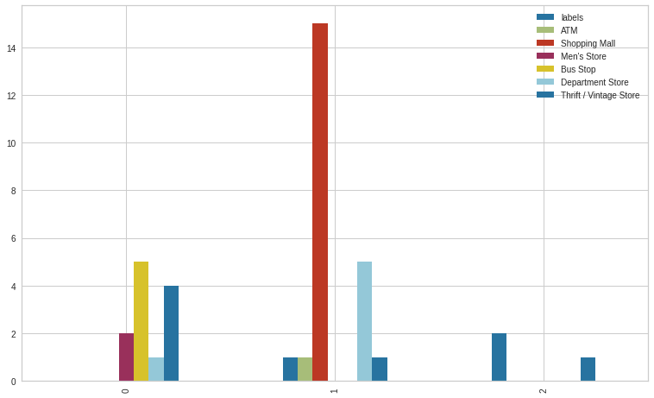
Sum Venues By Cluster
Here the chart that show us the sum of the venues of
the population ,through out our chart we can see that the third cluster has the best rate .

Slide 5
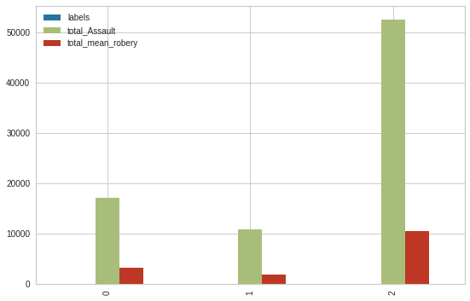
Total asault and robery By Cluster
Here the chart that show us the Total assault & robery
of the population, the ratio of assault is 10778.800971 and the robbery ratio is 1955.913922 so the second cluster has the best rate

Slide 6
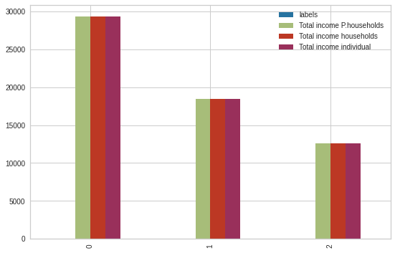
Average Income By Cluster
Here the chart that show us the average of the income's population , we can see the
best rate is the First Cluster.

Slide 7

AUDIENCE
The management team needs to do a site study to see which is the best place in Toronto that will be best to install it. and everyone who needs to analyze an area either for a product, a service or to install a service.

Slide 8
Neighbourhoods crime rates
https://data.torontopolice.on.ca/datasets/neig hbourhood-crime-rates-2020-1/explore? showTable=true
Shooting and Firearm Discharges
https://data.torontopolice.on.ca/datasets/shoo tings-and-firearm-discharges/explore? showTable=true
REFERENCE & APENDICES
Profile dataset
https://www.toronto.ca/city-government/data- research-maps/neighbourhoods- communities/neighbourhood-profiles/

Slide 9
OUR RECOMMENDATIONS AND CONCLUSIONS
Avoid areas with high crime rates and assault
Select the most frequented and least competitive areas
Select areas where total incomes are high and have a very high youth population
Part 10:
recommendations

Slide 10
Matteucci Cyril
Thank you!

